Slide 1
Building Europe with
Local Councillors
A network of EU local councillors, working
together to communicate on EU issues
Building Europe with
Local Councillors

Slide 2
What is
“Building Europe with
Local Councillors”?
Building Europe with
Local Councillors

Slide 3
The EU project “Building Europe with Local Councillors” is based on the principle that communicating about the EU is a shared responsibility of EU institutions and of Member States’ authorities, including and starting from the local level.
What is "Building Europe with Local Councillors"?
Building Europe with
Local Councillors

Slide 4
We encourage local authorities of all sizes, especially smaller ones (population below 100 000) and less targeted by EU outreach activities, to apply and become members.
Who can
join the project?
Building Europe with
Local Councillors

Slide 5
How to join the network — the registration process
Building Europe with
Local Councillors

Slide 6
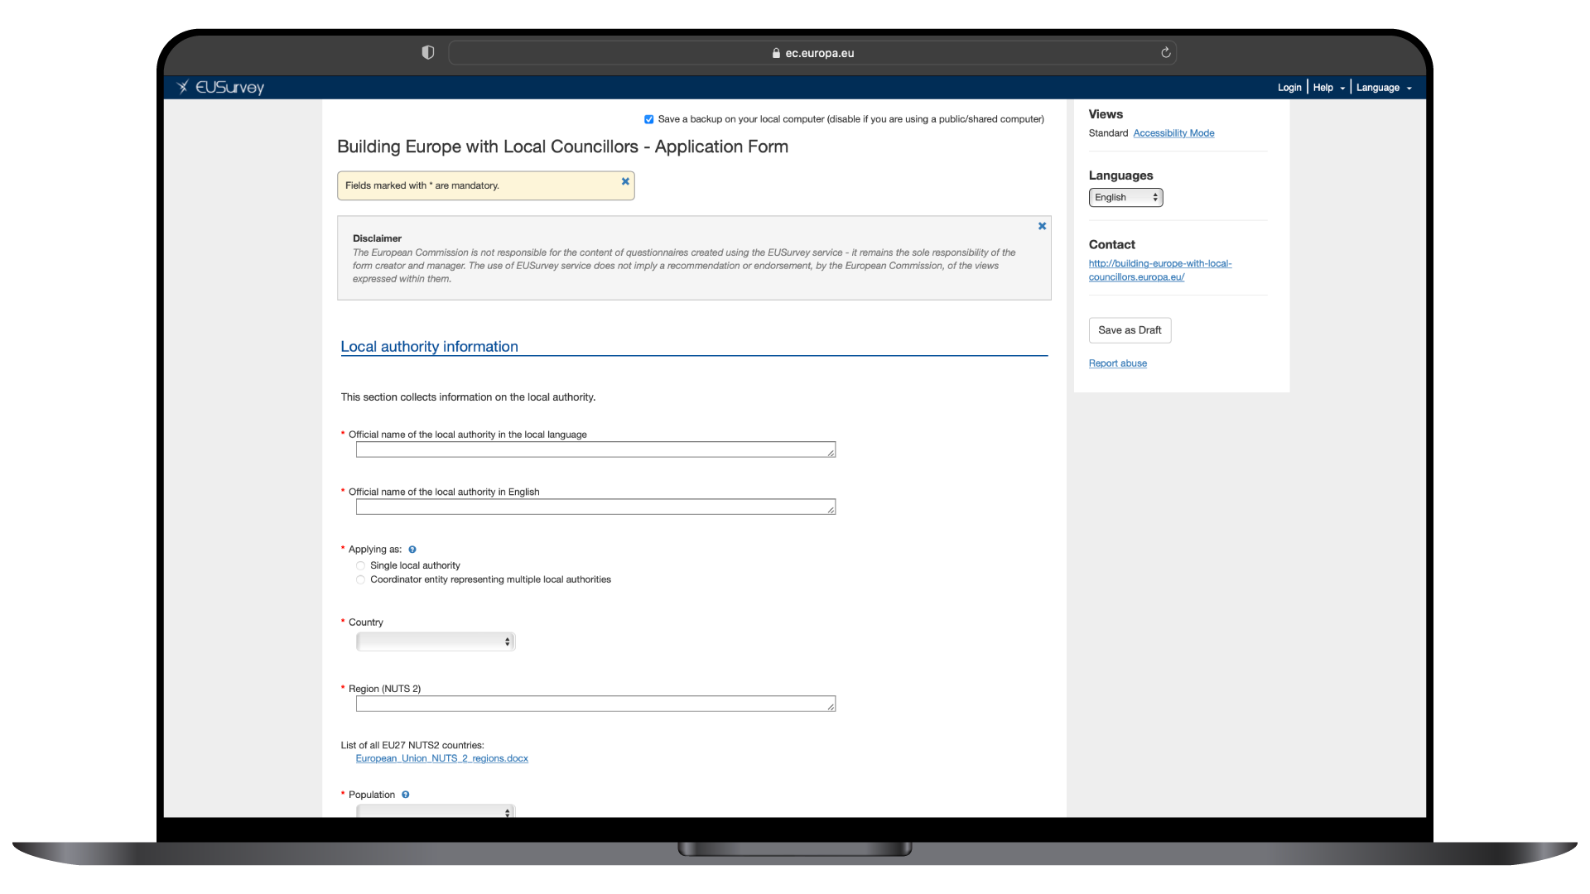
To apply, the local authority needs to fill in an application form indicating the name of the local councillor designated to become a network member.
How to join the network – the registration process
Building Europe with
Local Councillors

Slide 7
To apply, the local authority needs to fill in an application form indicating the name of the local councillor designated to become a network member.
How to join the network – the registration process
Building Europe with
Local Councillors

Slide 8
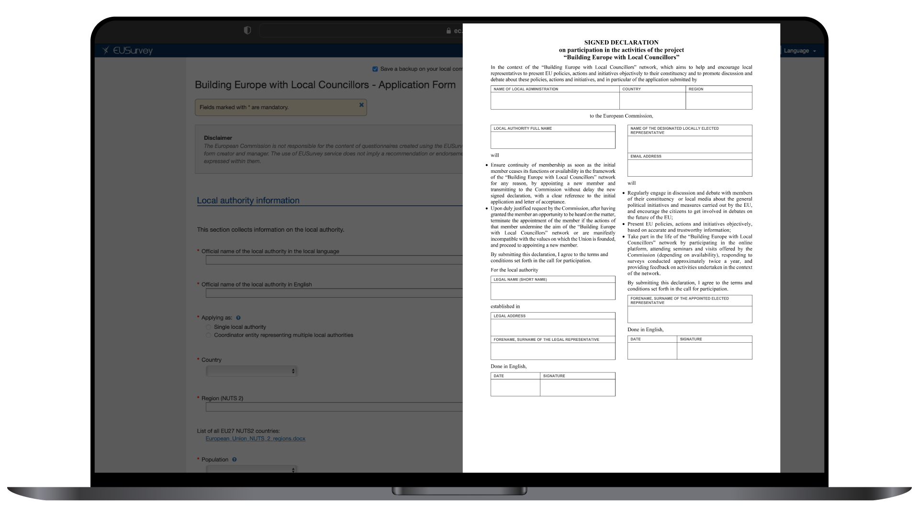
The online application form is accompanied by a signed declaration which expresses the interest and commitment of the signatories in communicating Europe on the ground. This declaration needs to be signed by both the local authority’s legal representative, and the designated local councillor.
How to join the network – the registration process
Building Europe with
Local Councillors

Slide 9
The online application form is accompanied by a signed declaration which expresses the interest and commitment of the signatories in communicating Europe on the ground. This declaration needs to be signed by both the local authority’s legal representative, and the designated local councillor.
How to join the network – the registration process
Building Europe with
Local Councillors

Slide 10
Local authority partner of the Commission in communicating Europe on the ground
Locally elected representative appointed by the local authority member of the “Building Europe with Local Councillors” network
How the
network will work
Building Europe with
Local Councillors

Slide 11
5 key benefits of participating in this network
Building Europe with
Local Councillors

Slide 12
5 key benefits of participating in this network
Privileged access to official EU communication sources in national languages, communication material, online and offline seminars and other forms of information allowing members to engage with citizens on EU issues.
Access to priority visits to the European Commission Visitors’ Centre in Brussels, either physical or digital, organised, when possible, in their language.
Access to a lively peer network through a dedicated online platform with other network participants.
Visibility at EU level of the member’s activities undertaken in the context of the network.
Privileged access to a multitude of EU outreach networks, including over 420 EUROPE DIRECT centres present in almost all EU regions.
Building Europe with
Local Councillors

Slide 13
Specific Survey
Building Europe with
Local Councillors

Slide 14
By responding to the specific survey you will have the chance to provide the topics which are most relevant for your communication needs in your constituency.
Following your participations to the EU Specific survey, you will have the chance to
- receive relevant EU-related information
- participate in online seminars
- participate in visits to the EU institutions in your language
URL to the specific survey: https://ec.europa.eu/eusurvey/runner/BELC-specific-survey
Specific Survey
Building Europe with
Local Councillors

Slide 15
Partnership with the
Committee of the Regions
Building Europe with
Local Councillors

Slide 16
Partnership with the
Committee of the Regions
The “Building Europe with Local Councillors” network benefits from close
coordination with the EU Committee of the Region’s European Network of Regional and Local EU Councillors.
The European Network of Regional and Local EU Councillors, set up by the European Committee of the Regions (CoR) in 2021, shares some of the same objectives as our network, such as increasing knowledge of EU policies among local councillors and supporting them in their EU-related activities.
While our network is focused mainly on communication with citizens, the network of
the Committee of the Region aims to create links with the work of Committee of
the Region members.
You can become a member of both networks!
Building Europe with
Local Councillors

Slide 17
What are network members expected to do?
Building Europe with
Local Councillors

Slide 18
What are network members expected to do?
Engage in debate with members of their constituency and local media about general political initiatives and measures carried out by the EU.
Present EU policies, actions and initiatives objectively, based on accurate and trustworthy information.
Take part in the life of the network, including for example responding to surveys approximately twice a year.
Building Europe with
Local Councillors

Slide 19
Joining the network what happens next?
Building Europe with
Local Councillors

Slide 20
Joining the network
what happens next?
Once a local authority and its designated councillors are accepted as partner and member of the project, they will:
receive visibility materials to publicise their participation in the project, including a printable certificate for the member, a metal plate and a roll-up for the local authority to be displayed in places open to the public
be listed on the public website as project members
gain access to an online information platform
begin receiving material and updates about the project activities via email
In addition, local councillors will receive an onboarding survey of their interests and information needs. They will also be invited to online and offline information meetings related to their topic of interest and information needs.
Building Europe with
Local Councillors

Slide 21
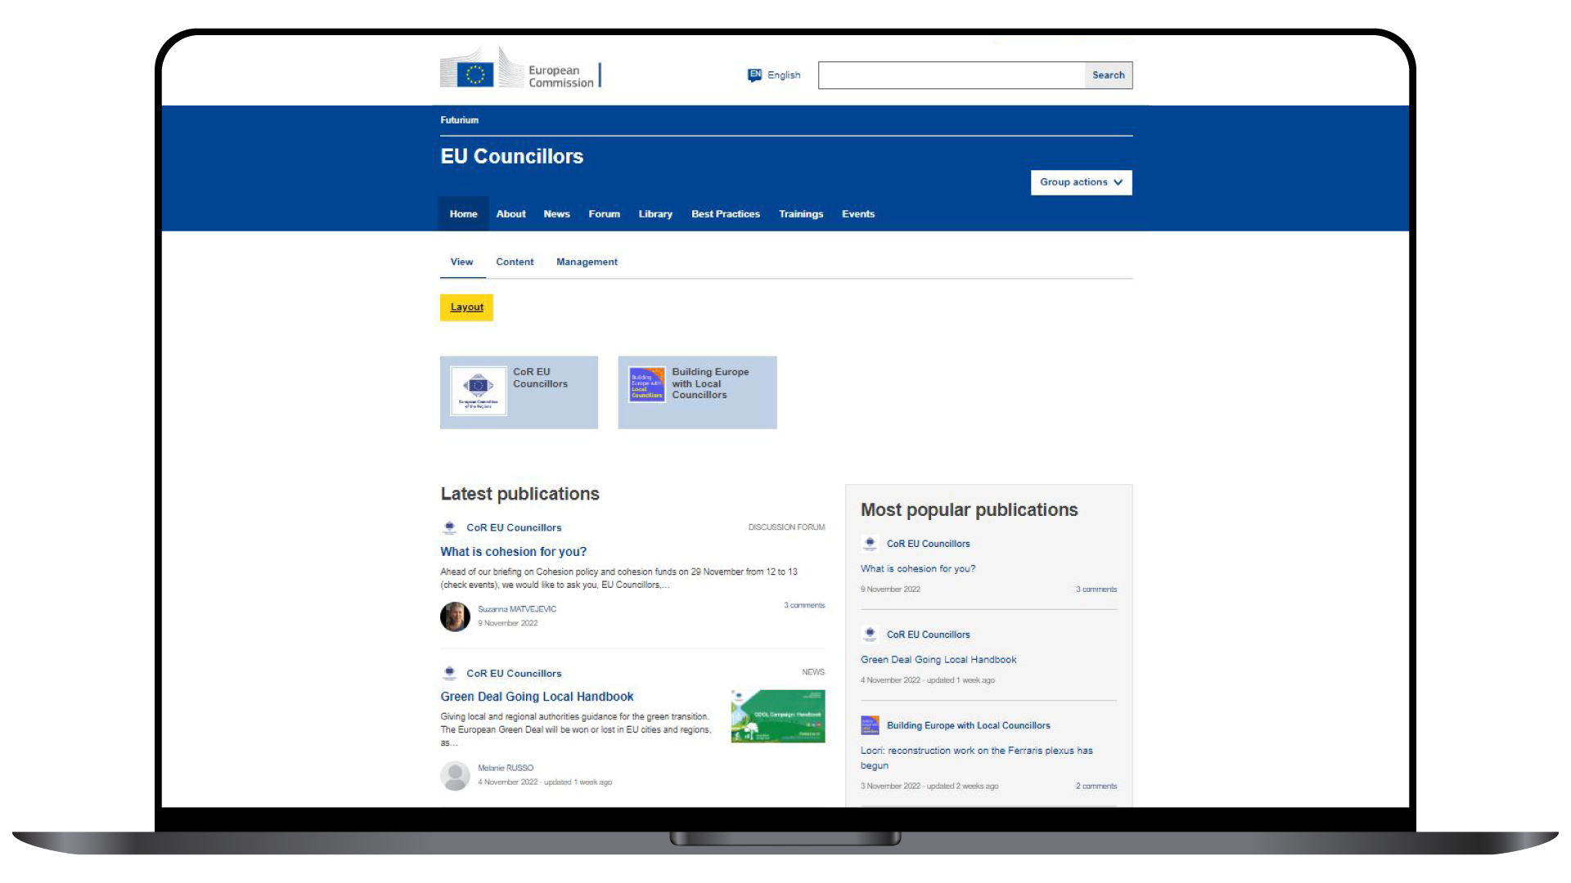
The online communication platform for the members of Building Europe with Local Councillors is hosted on the European Commission Futurium platform (https://futurium.ec.europa.eu).
Members will need to register to EU login to receive access to the platform.
Joining the network
what happens next?
Building Europe with
Local Councillors

Slide 22
The online communication platform for the members of Building Europe with Local Councillors is hosted on the European Commission Futurium platform (https://futurium.ec.europa.eu).
Members will need to register to EU login to receive access to the platform.
Joining the network
what happens next?
Building Europe with
Local Councillors

Slide 23
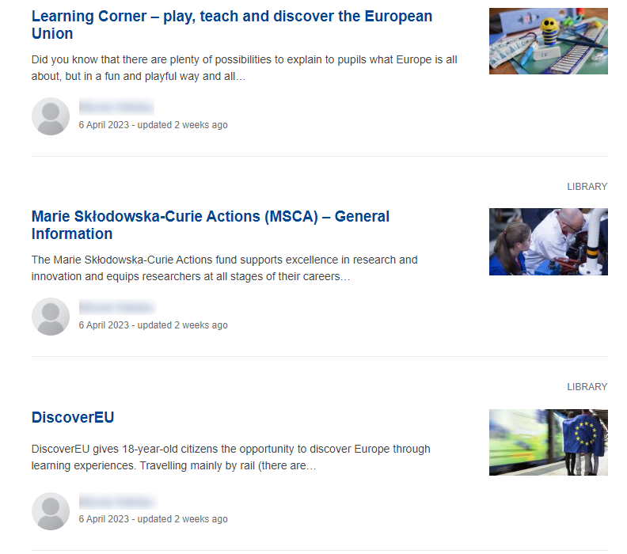
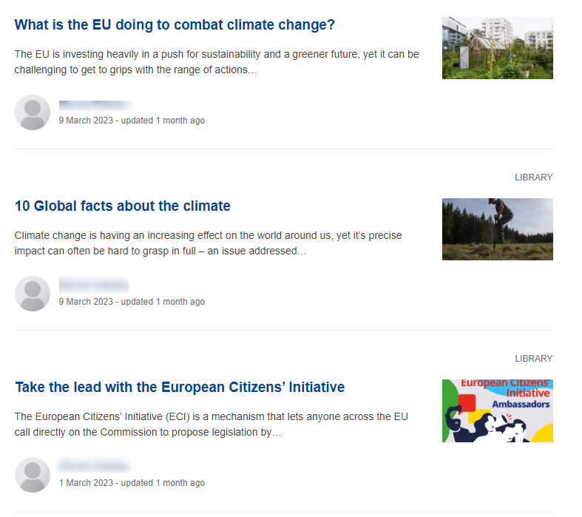
The online communication platform for members
Building Europe with Local Councillors group
Building Europe with
Local Councillors

Slide 24
The online communication platform for members
What content is available on the platform?
Information corresponding to the topics of interest and information needs expressed by members in the onboarding survey
A discussion forum for peer learning among members and sharing experiences
Selected information material
A calendar of offline and online events
A joint group with members of the Committee of the Regions’ Local and Regional Councillors (see next slide)
Building Europe with
Local Councillors

Slide 25
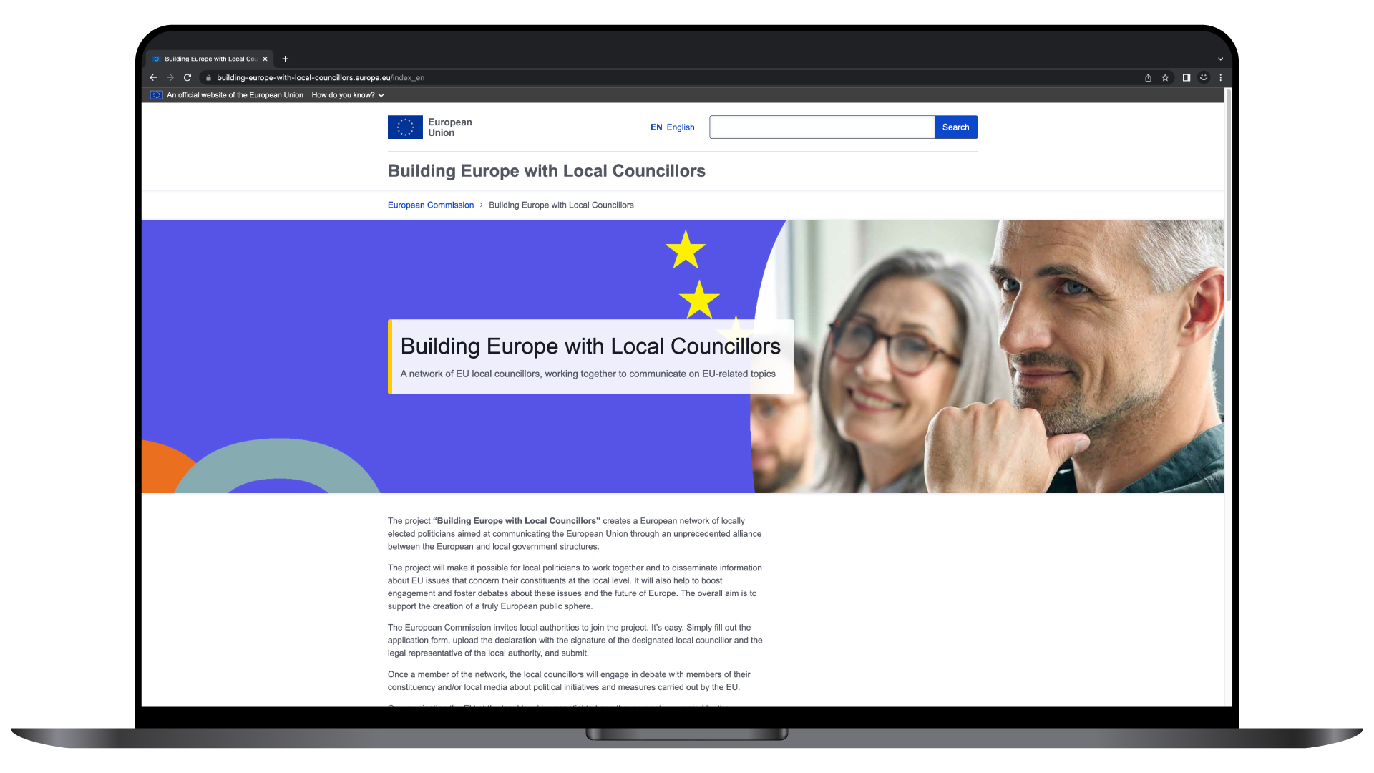
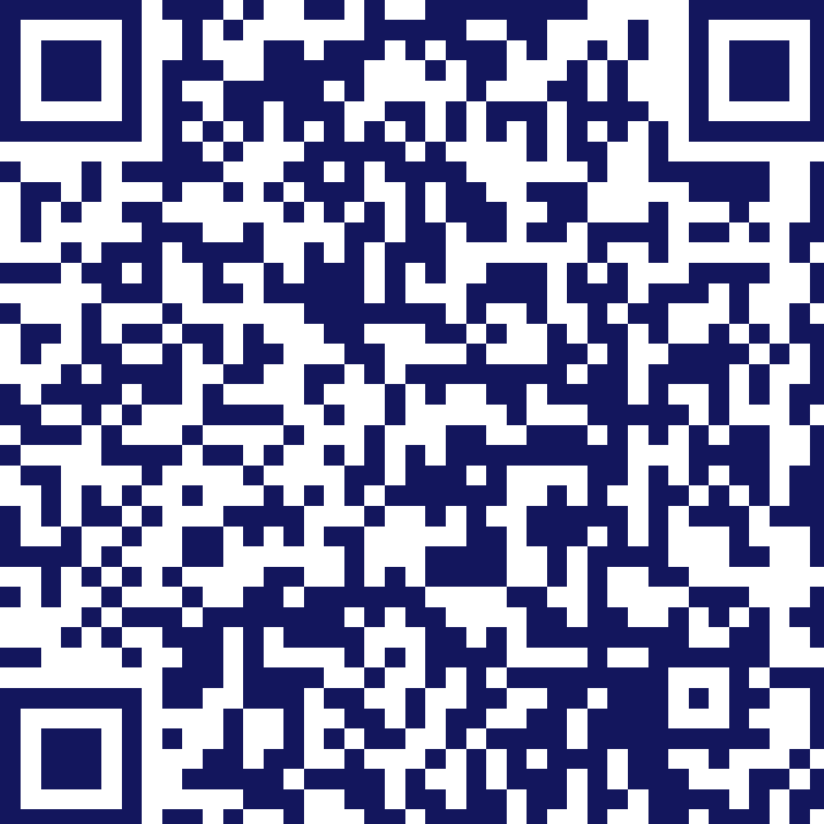
building-europe-with-local-councillors.europa.eu
Building Europe with
Local Councillors

Slide 26


Thank You
Building Europe with Local Councillors
A network of EU local councillors, working together to communicate on EU issues
Contact: info@eu-councillors.eu

